Slide 1
Satisfiability Problems
Instructor: Yao-Ting Huang
Bioinformatics Laboratory,
Department of Computer Science & Information Engineering,
National Chung Cheng University.

Slide 2
P and NP
P
Decision problems that can be answered by a deterministic Turing machine in polynomial time.
NP
Decision problems that can be answered by a non-deterministic Turing machine in polynomial time.

Slide 3
NP-Complete
Definition of NP-Hard:
If all problems in NP are reducible to P, then P is called NP-Hard
Definition of NP-Complete:
P is NP-Complete if P is NP-Hard and P ∈ NP
If P ≤_{p} Q and P is NP-Hard, Q is also NP-Hard.
NP
NP Complete
P

Slide 4
NP-Complete
If P ≤_{p} Q and P is NP-Hard, Q is also NP-Hard.
Show all P inputs are subset/special cases of Q inputs.
Q
P
NP
4

Slide 5
Satisfiability (SAT) Problem
The SAT problem is to determine whether a boolean expression is satisfiable.
2^{n} different truth assignments.
Truth assignment即真值表 ex.x=T,y=T,w=T
Is the following expression satisfiable?
¬(x∧¬z∧(¬w∨x))∨(x∧¬y)∨¬y

Slide 6
What Do We Know?
Checking if a boolean expression is satisfiable (SAT) is NP-hard.
We concentrated on the Conjunctive Normal Form (CNF),de Morgan’s law
A boolean expression with the product (AND) of several sums (OR).
All expressions can be converted into CNF form.
Example: propositional calculus formula
¬(x∧¬z∧(¬w∨x))∨(x∧¬y)→¬y
(..∨..∨.....∨..)∧…∧(..∨..∨.....∨..)

Slide 7
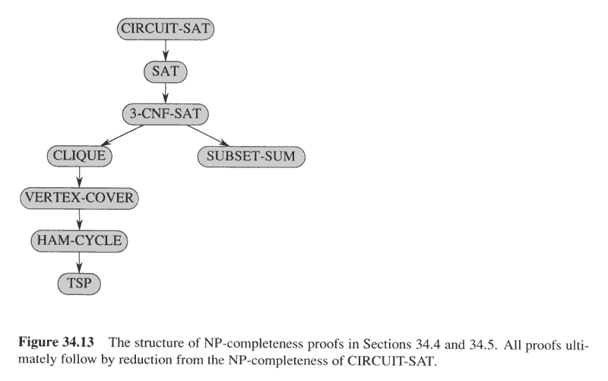
2SAT => polynomial time
但
3SAT、4SAT… => not polynomial

Slide 8

3SAT vs SAT(不限制多少variables)
3SAT: Give a Boolean expression in CNF where each clause has exactly 3 variables, determine satisfiability.
Let’s try reduction from SAT (in CNF).
Note that 3-SAT is just a special case of SAT when each clause have three literals.
¬x∧(x∨¬z)∧(¬w∨x∨¬y)∧(x∨¬y∨w∨z)
$$(x_{1}∨¬x_{2}∨¬x_{3})∧(x_{1}∨x_{2}∨x_{4})∧(¬x_{1}∨¬x_{3}∨¬x_{4})$$

Slide 9

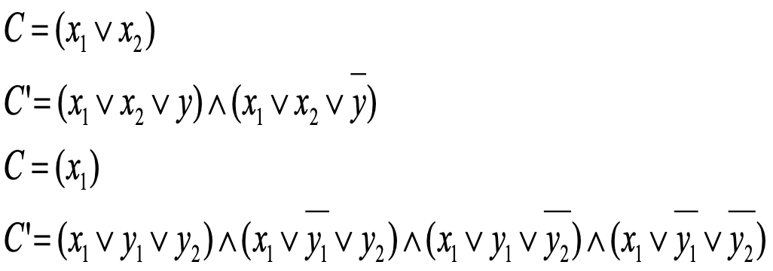
NP-Completeness Proof: 3SAT
Proof:
Let be an arbitrary clause in SAT.
For k = 3, no need of change.
For k = 1 or 2, reduce the clause into 3SAT by adding auxiliary literals y.

Slide 10
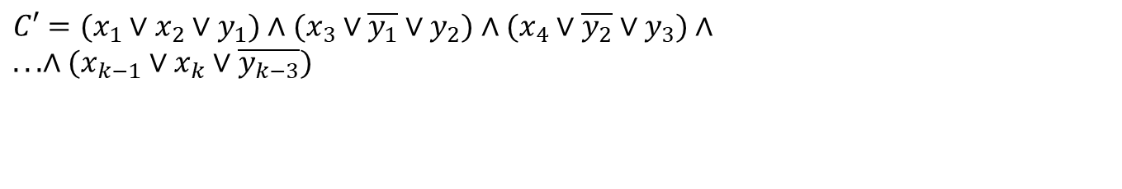
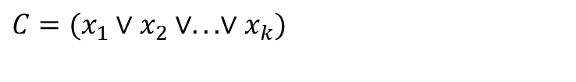
3SAT
Proof:
Let be an arbitrary clause of the SAT problem.
For k ≥ 4, map all k literals in the following way.
$$C=(x_{1}∨x_{2}∨...∨x_{k})$$
$$C′=(x_{1}∨x_{2}∨y_{1})∧(x_{3}∨\overline{y_{1}}∨y_{2})∧(x_{4}∨\overline{y_{2}}∨y_{3})∧ \\ ...∧(x_{k−1}∨x_{k}∨\overline{y_{k−3}})$$
SAT Yes if and only if 3SAT

Slide 11
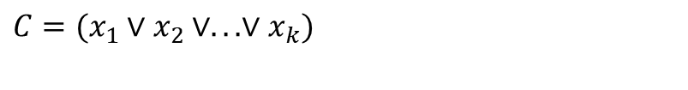
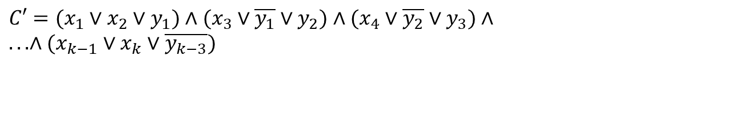
NP-Completeness Proof: 3SAT
C’ is satisfiable iff C is satisfiable:
C’= 1 means that at least one x_{i} = 1. Thus C = 1.
By contradiction. Suppose all x_{i} = 0. it is impossible to satisfy C’.
$$C=(x_{1}∨x_{2}∨...∨x_{k})$$
F
F
T
F
$$C′=(x_{1}∨x_{2}∨y_{1})∧(x_{3}∨\overline{y_{1}}∨y_{2})∧(x_{4}∨\overline{y_{2}}∨y_{3})∧ \\ ...∧(x_{k−1}∨x_{k}∨\overline{y_{k−3}})$$
F
F
F
Notes:
y1 should be true imply y2, y3 … have to be true.

Slide 12
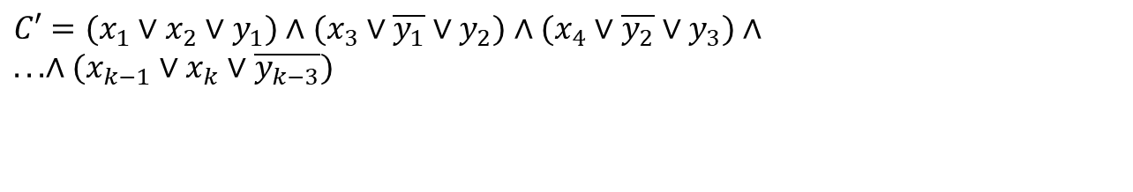
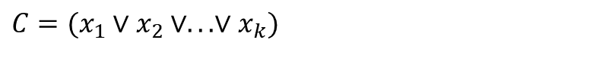
NP-Completeness Proof: 3SAT
C’ is satisfiable iff C is satisfiable:
C = 1 ⇒ at least one x_{i} = 1
⇒ can set y_{i}’s so that C’ = 1
$$C=(x_{1}∨x_{2}∨...∨x_{k})$$
T
T
F
F
T
F
$$C′=(x_{1}∨x_{2}∨y_{1})∧(x_{3}∨\overline{y_{1}}∨y_{2})∧(x_{4}∨\overline{y_{2}}∨y_{3})∧ \\ ...∧(x_{k−1}∨x_{k}∨\overline{y_{k−3}})$$

Slide 13
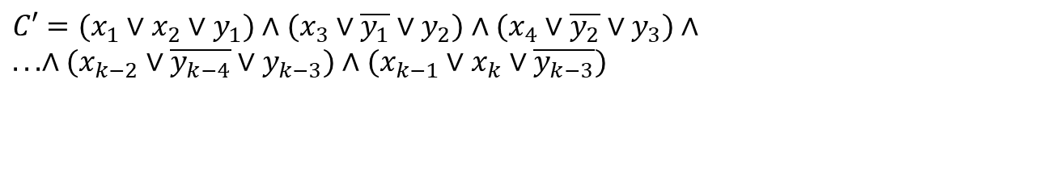
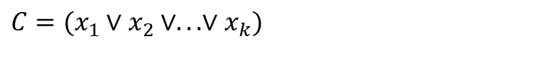
NP-Completeness Proof: 3SAT
C’ is satisfiable iff C is satisfiable:
C’= 1 ⇒ at least one x_{i} = 1 ⇒ C = 1
C = 1 ⇒ at least one x_{i} = 1 ⇒ can set y_{i}’s
so that C’ = 1
$$C=(x_{1}∨x_{2}∨...∨x_{k})$$
$$C′=(x_{1}∨x_{2}∨y_{1})∧(x_{3}∨\overline{y_{1}}∨y_{2})∧(x_{4}∨\overline{y_{2}}∨y_{3})∧ \\ ...∧(x_{k−2}∨\overline{y_{k−4}}∨y_{k−3})∧(x_{k−1}∨x_{k}∨\overline{y_{k−3}})$$

Slide 14
Summary
3-SAT is also NP-hard, not simpler than SAT.
The reduction works in polynomial time.
All SAT instances can be reduced to 3-SAT by the reduction.
How about 4-SAT, 5-SAT, …?

Slide 15
Question
How to prove that all k-SAT problems, where k≥3, are NP-hard?

Slide 16
2SAT is in P
Instance: A 2-CNF formula ϕ
Problem: To decide if ϕ is satisfiable
Check if there exists a truth assignment satisfying ϕ
Example: a 2CNF formula
(¬x∨y)∧(¬y∨z)∧(x∨¬z)∧(z∨y)

Slide 17
2SAT
Is 2SAT NP-hard?
Example: a 2CNF formula
(¬x∨y)∧(¬y∨z)∧(x∨¬z)∧(z∨y)

Slide 18
Implication
If any literal in a 2-SAT clause is false, the other must be true (called implication).
.g., If z is false, y must be true.
(¬x∨y)∧(¬y∨¬ z)∧(x∨¬z)∧(z∨y)

Slide 19
Implication Graph
Vertex for each variable and a negation of a variable
Edge (α, β) iff there exists a clause equivalent to (¬α∨β).
¬x
y
只要沒有”矛盾”即可回答yes
“矛盾”為
x不可強連通到-x
y不可強連通到-y…
x
¬y
¬z
z
(¬x∨y)∧(¬y∨z)∧(x∨¬z)∧(z∨y)

Slide 20

Transitive Implications
Suppose X=T. Y must be T in order to satisfy (-X$∪$ Y)
Since Y=T, Z must be T in order to satisfy (-Y $∪$Z)
¬x
y
T
x
¬y
¬z
z
(¬x∨y)∧(¬y∨z)∧(x∨¬z)∧(z∨y)

Slide 21
Implication
If x is true, y must be true.
But if x is false, y does not necessary have to be true.
Satisfiable example: (x ∨ y) ∧ (x ∨ -y)
x
y
¬x
¬y

Slide 22
Implication
If x is true, y must be true.
But if x is false, y does not necessary have to be true.
Satisfiable example: (x ∨ y) ∧ (x ∨ -y)
-x -> y -> x
-x -> -y -> x
Can’t set –x to be true.
Can only set –x to be false.
Satisfiable by letting (x, y) = (T, F) or (T, T).
x
y
¬x
¬y

Slide 23
Implication Graph
If x is true, y must be true.
Unsatisfiable example: (x ∨ y) ∧ (-y ∨ x) ∧ (y ∨ -x) ∧ (-x ∨ -y)
-x -> y -> x
Can not set x to be false.
x -> -y -> -x
Can not set x to be true.
Same argument for y and -y
Unsatisfiable.
x
y
¬x
¬y

Slide 24
Observation
Suppose there are paths x…¬x and ¬x…x for some variable x.
If x =TRUE, ¬x has to be TRUE, a contradiction.
Get another contradiction by setting ¬x = TRUE.
x
. . .
α
β
. . .
¬x
T
T
T
T

Slide 25
Observation
Claim: a 2-CNF formula ϕ is unsatisfiable iff
there exists a variable x, such that:
1. there is a path from x to ¬x in the graph and
2. there is a path from ¬x to x in the graph
That is, x and ¬x are in the same strongly connected component

Slide 26
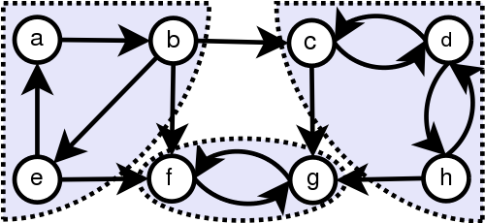
Strongly Connected Component
A directed graph is called strongly connected if each vertex is reachable from every other vertex.
Strongly connected components can be found by running two DFS on the graph and transpose graph.

Slide 27
Algorithms for Computing SCC
Kosaraju, two passes of DFS
Tarjan, one pass of DFS with one stack
Dijkstra, one pass of DFS with two stacks

Slide 28
Compute Strongly Connected Component
StronglyConnectedComponents(G)
1. Call DFS(G) to compute finishing times f[u] for each vertex u
2. Compute G^{T}
3. Call DFS(G^{T}), but in the main loop of DFS, consider the vertices in order of decreasing f[u].
4. Output the vertices of each tree in the depth-first forest of step 3 as a separate strongly connected component
Time: Θ(V+E)

Slide 29
1. Call DFS(G) to compute finishing times f[u] for each vertex u
a
b
c
d
13/14
11/16
1/10
8/9
G:
12/15
3/4
2/7
5/6
e
f
g
h

Slide 30
2. Compute G^{T}
a
b
c
d
13/14
11/16
1/10
8/9
G:
12/15
3/4
2/7
5/6
e
f
g
h
a
b
c
d
13/14
11/16
1/10
8/9
G^{T}:
12/15
3/4
2/7
5/6
e
f
g
h

Slide 31
3. Call DFS(G^{T}), but in the main loop of DFS, consider the vertices in order of decreasing f[u].
cd
a
b
c
d
13/14
11/16
1/10
8/9
abe
h
G^{T}:
12/15
3/4
2/7
5/6
fg
e
f
g
h

Slide 32
Correctness
Let C and C’ be two distinct SCCs.
Suppose there is an edge (u,v) where u in C and v in C’.
Let f(C) be the finish time of the 1st DFS.
f(C) > f(C’)
G
C
C’
SCC3

Slide 33
Correctness
Let C and C’ be two distinct SCCs.
Suppose there is an edge (u,v) in G^{T} where u in C and v in C’.
Let f(C) be the finish time of the 1st DFS.
f(C) < f(C’)
G
G^{T}
C’
C
C’
C
SCC3
SCC3

Slide 34
Correctness
Because we start 2nd DFS from the maximum finish time (e.g., SCC1), it always visits vertices within the same SCC but not other SCCs.
G
G^{T}
SCC1
SCC2
SCC1
SCC2
SCC3
SCC3

Slide 35
2SAT is in P
We get the following efficient algorithm for 2SAT:
For each variable x and –x check if they are in the same strongly connected component.
Reject if any of these tests succeeded.
Accept otherwise
2SAT∈P.
3SAT,4SAT,… NP-complete

Slide 36
Finding a Truth Assignment
Topological sort on the component graph.
Each strongly connected component contracts as a vertex.
Topological sort the contracted vertices.
From reverse topological order, set all the literals in the component to be true, if the variable is not set yet.
This also causes all of the terms in the complementary component to be set to false.
x
y
(x ∨ y) ∧ (x ∨ -y)
¬x
¬y

Slide 37
Max2SAT
Max2SAT:
Decide if there is a truth assignment satisfying at least K clauses.
Is Max2SAT in P?
Example: a 2CNF formula
(¬x∨y)∧
(¬y∨z)∧
(x∨¬z)∧
(z∨y)

Slide 38
Conclusion
SAT is NP-complete.
k-SAT is NP-complete, for k≥3.
2-SAT is in P.
Max2SAT is NPC.
In reality, we often solve the maximization version of this problem?
Find a truth assignment satisfying maximum clauses.
MaxSAT, Max3SAT, …
All of them are NPC.

